Slide 1
TIC-TAC-TOE GAME

Slide 2
PRESENTATION OVERVIEW
Objective
Project Introduction
Problem Statement
Modules Used
Architecture of the proposed system
Merits and Demerits proposed system
Program Execution and Output

Slide 3
OBJECTIVE
The objective of the Tic Tac Toe game is to be the first player to place three of their symbols in a row, either horizontally, vertically, or diagonally. This is commonly referred to as getting “three in a row” or creating a “winning line”.

Slide 4
PROJECT OVERVIEW
The tic-tac-toe game is for two players. One player plays X and the other plays O. The players take turns placing their marks on a grid of three-by-three cells. If a given player gets three marks in a row horizontally, vertically, or diagonally, then that player wins the game.

Slide 5
PROBLEM STATEMENT
Once a winning condition is reached, no more moves are allowed. A player who succeeds in placing n of their marks in a horizontal, vertical, or diagonal row wins the game.

Slide 6
MODULES USED
This article will guide you and give you a basic idea of designing a game Tic Tac Toe using pygame library of Python. Pygame is a cross-platform set of Python modules designed for writing video games.

Slide 7
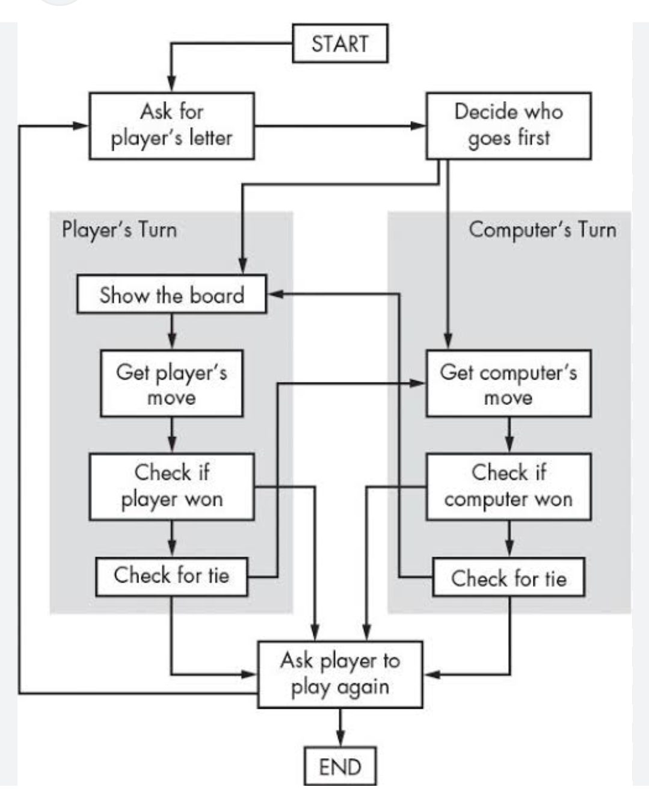
ARCHITECTURE OF THE PROPOSED SYSTEM

Slide 8
MERITS AND DEMERITS OF THE PROPOSED SYSTEM
Merits:
Playing tic tac toe with preschoolers can be a fun and engaging way to help them develop many valuable skills, such as problem-solving, teamwork and cooperation, fine motor skills, language development, memory, attention, focus, self-esteem, and creativity.
Demerits:
If played optimally by both players, the game always ends in a draw, making tic-tac toe a futile game.

Slide 9
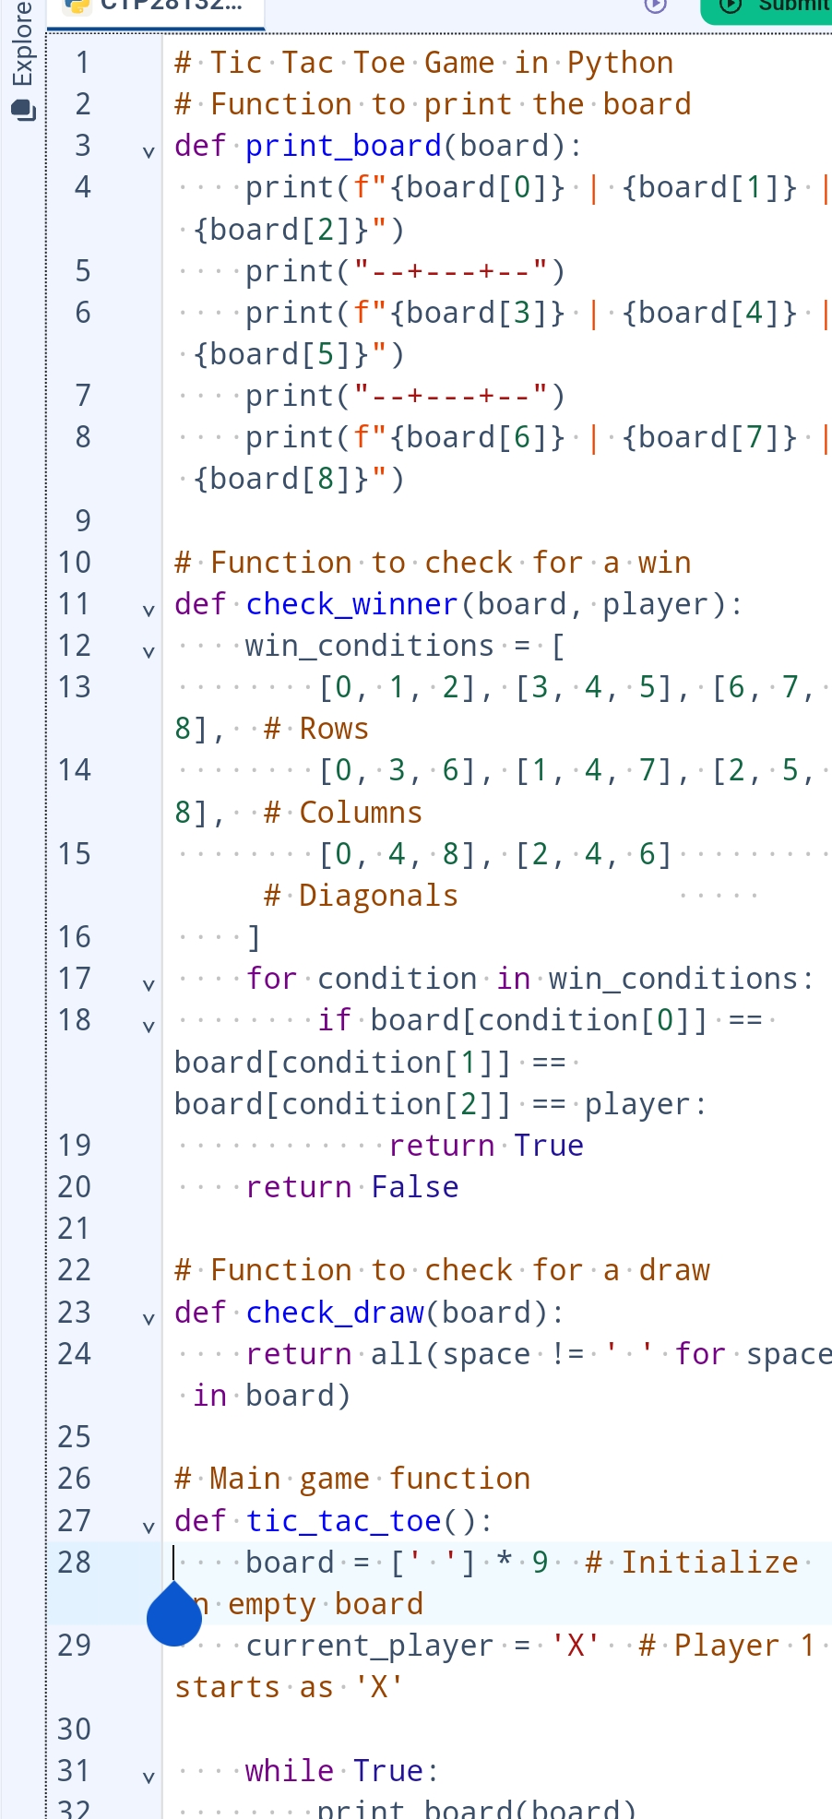
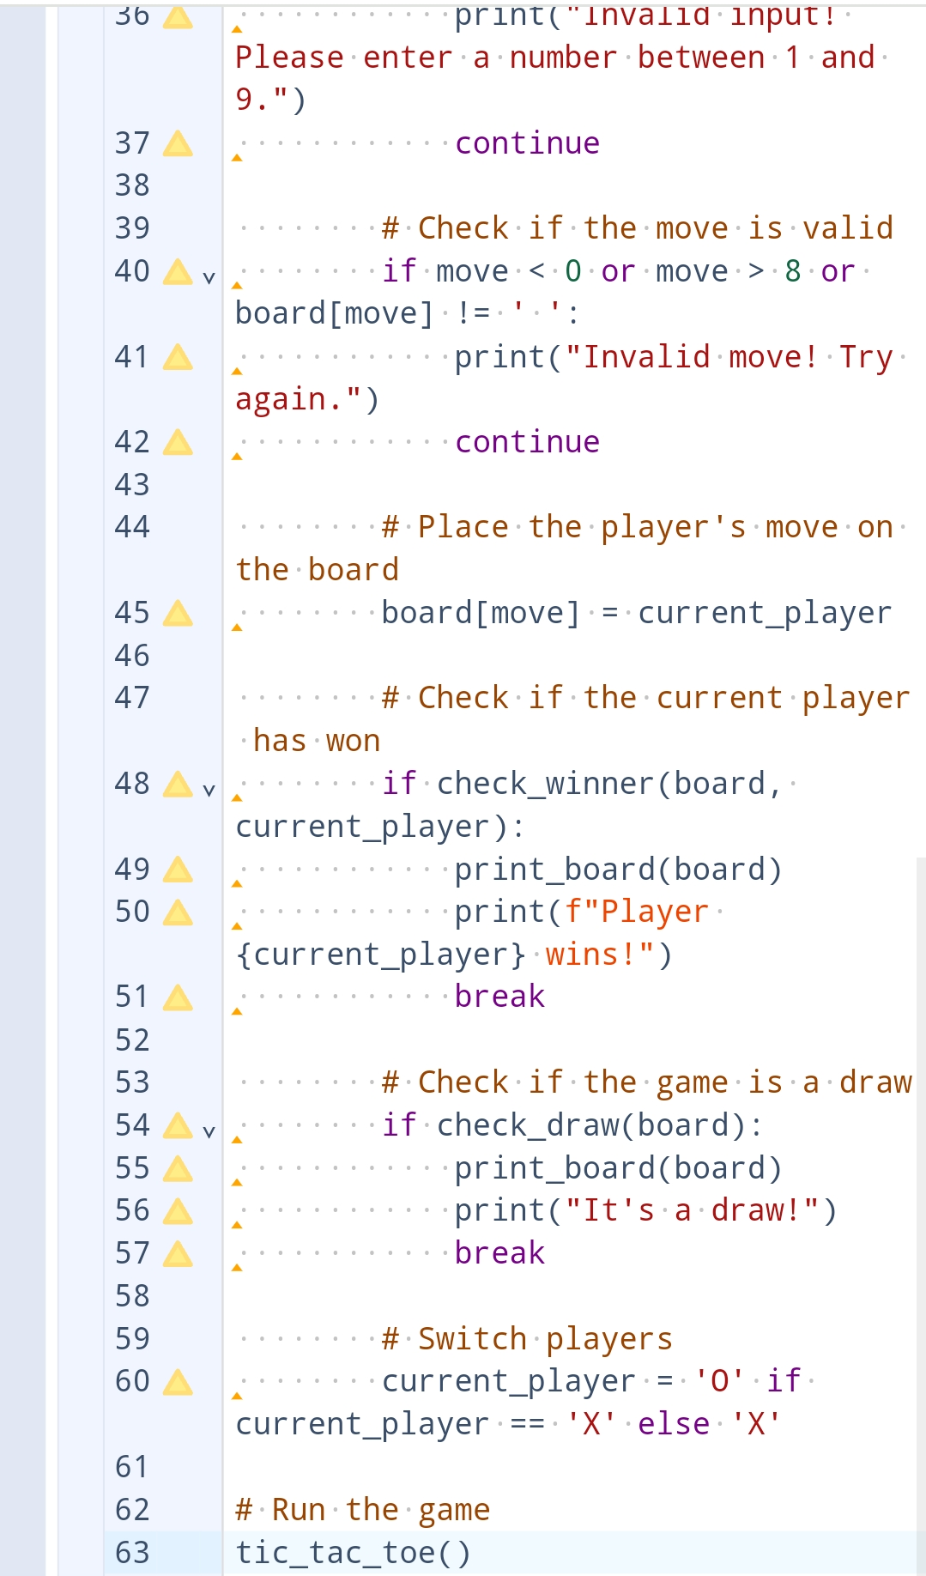
PROGRAM EXECUTION AND OUTPUT

Slide 10
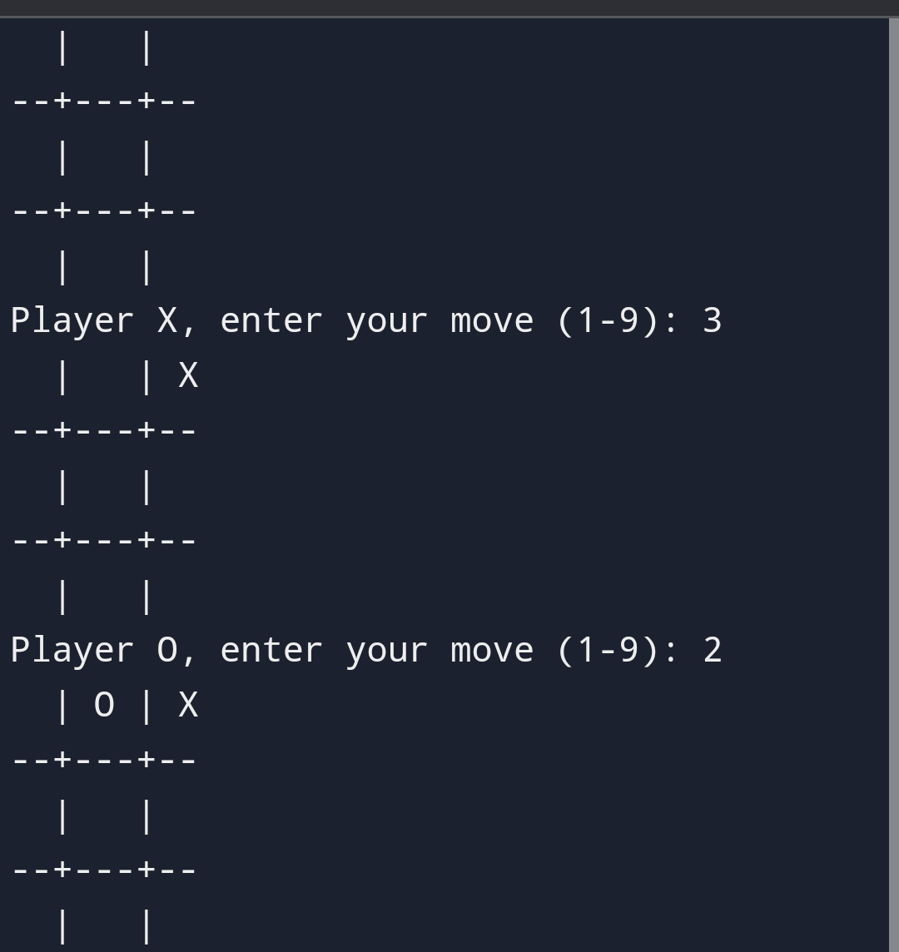
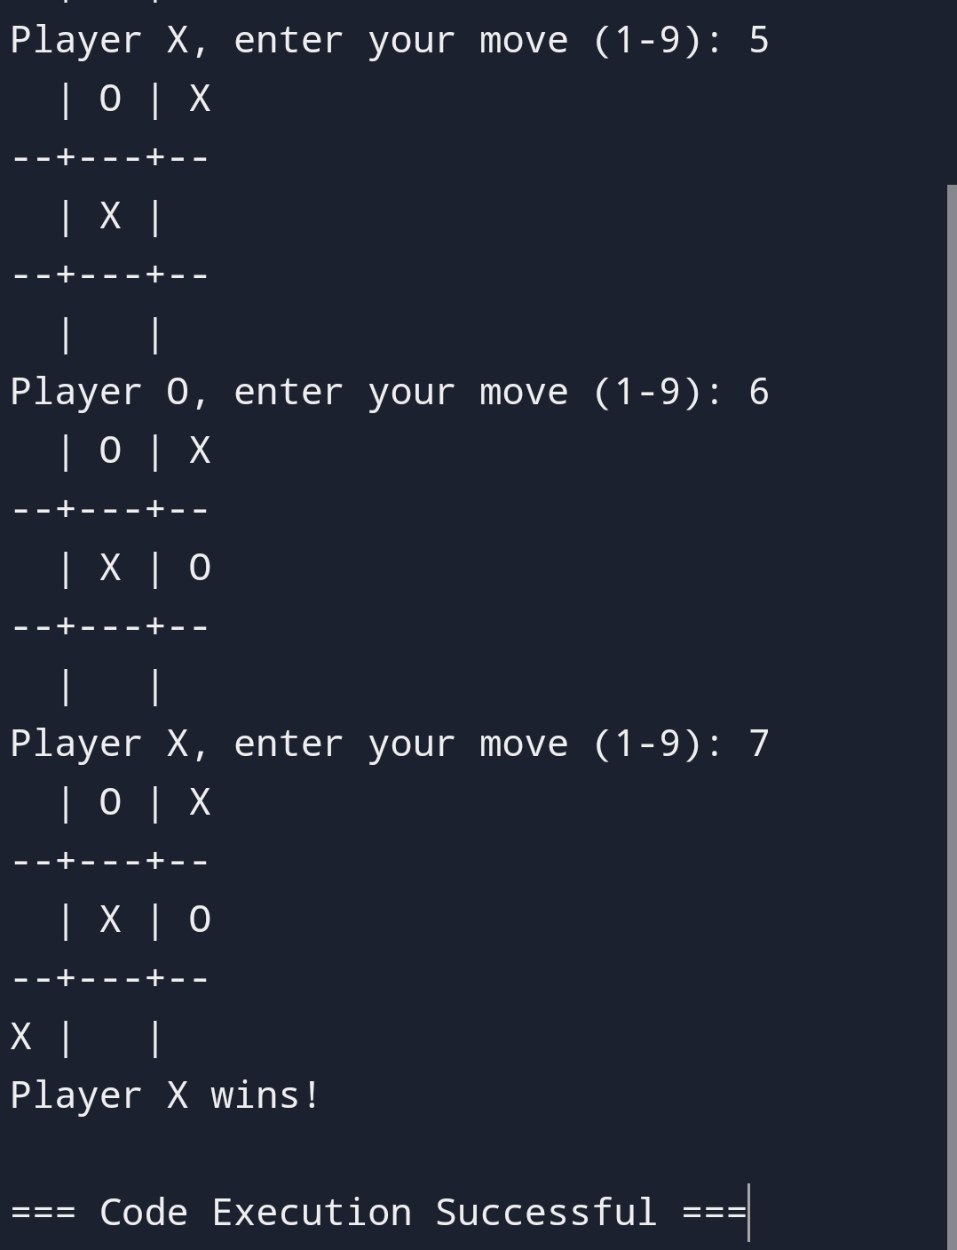
OUTPUT

